Slide 1
SIGN LANGUAGE RECOGNITION BY USING MACHINE LEARNING ALGORITHMS
Group Members
Shourya Jha (R17EC371)
Ayush Rai (R17EC031)
T.Muskan (R18EC832)
Varshitha.L (R18EC835)
Group No: 110
Group Name: ASTV
Project Guide: Prof. Madan HT

Slide 2
Contents
Abstract
Introduction
Literature Survey
Problem Definition/ Objective
Methodology
Implementation
Results and discussion
Paper progress
Applications
References

Slide 3
Abstract
Human beings can easily communicate with each other, but people with disabilities(deaf and dumb) find it difficult to communicate with other people without a translator.
The Sign Language becomes a barrier of communication for these people as they are highly dependent on non-verbal form of communication that involves hand gesture.
According to the World Health Organization (WHO), 466 million people across the world have disabling hearing loss (over 5% of the world's population), of whom 34 million are children . Studies expect these numbers to rise to 900 million by 2050.

Slide 4
This is the reason that the implementation of a system that recognize the sign language would have a significant beneficial impact on disabled people.
In this project we are trying to implement a method for the automatic recognition of the sign language by recognizing hand gestures using machine learning.

Slide 5
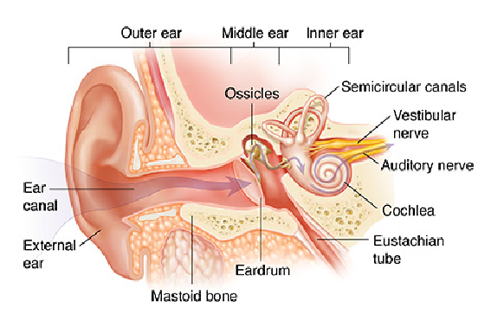
Introduction
The whole world comprises of different types of human beings, depending on different ways to communicate with each other where sign language is an exquisite language which is used by individuals with hearing impairment.
Hearing gives us capability to
perceive sounds, noises and
help us to communicate.
The sound from the source
travels as sound waves and
hits the ear drum and these
waves are converted to electrical signals and reaches the and helps us recognize the sound.
Fig 1: Anatomy of ear

Slide 6
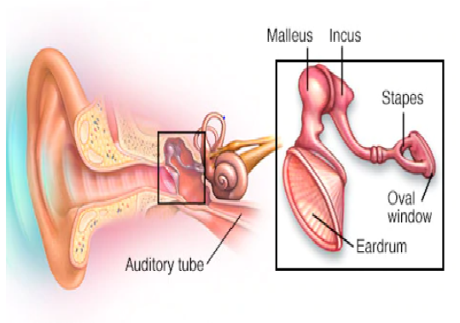
But during the transmission of sounds waves from ear to brain, an individual can lose their ability to hear sound partially and completely which is called as Hearing impairment.
Hearing loss is the third most common physical condition.
The most common way of communication for hearing impaired individuals is to communicate through Sign language.
Sign language is manual movement
of hands to express meaning full
communication.
Fig 2: Anatomy of middle ear

Slide 7
Different countries have different sign languages in alphabets and word sets, for example American has American Sign Language (ASL) and German has German Sign Language (GSL).
The similarity is that sign languages use body movements, right hand, left hand, or both.
As sign language is not universal so it’s not common with other people and takes a while to understand and communicate with people having hearing impairment.

Slide 8
Literature Survey
The work presented [1] propose a model where initially it pre-processes the dataset of 720 gesture images by resizing and global thresholding method and preserves the structural properties by canny edge detection, further feature extraction includes the usage of histogram and finally the results were observed using support vector machine with an accuracy of 93.75%.
Izzah [2] proposed a method consisting of skin detection where RGB to YCbCr to reserve luminance by taking in dataset of 380 images . As a next step Generic Fourier Descriptor is implemented for features extraction and filtering using mask is done. Ultimately for testing purpose, the pre-processed dataset is fed to Support Vector Machine, Principle component analysis with a performance percentage of 81.39 and 61.36

Slide 9
This paper[3] uses 2D wavelet transform for feature extraction and then uses multiclass SVM for classification. their methodology involves image aquisition , processing of image , feature extraction and then classification. the image was recorded and changed to black and white images and resized. wavelet transformation was applied to these preprocessed images. the feature vector obtained was given as input to SVM . they achieved an accuracy of 94% after training and testing over 350 samples.
In this paper[4] , initially the images are captured and image preprocessing is done to eliminate the unwanted noise and also to adjust the brightness . image segmentation is performed to identify the hand objects and boundaries of images. Then perform image analysis and apply convexity algorithm to extract the contour of the hand position. this method can only be used to detect numbers and hence becomes a drawback.

Slide 10
Sign in the form of gestures is given as an input to the system proposed in [5]. Further various steps are performed on the input sign image . Firstly segmentation phase is performed based on the skin color so as to detect the shape of the sign. The detected region is then transformed into binary image. Later, the Euclidean distance transformation is applied on the obtained binary image. Row and column projection is applied on the distance transformed image. For feature extraction central moments along with HU’s moments are used. For classification, neural network and SVM are used. Average accuracy for 13 feature sets obtained is 92.12%
In paper[6] recognition is done by translating the hands move sign language into an oral language. The system is inside to a glove with flex sensors in each finger that we are used to collect data that are analyzed through a methodology involving Data balancing with the Kennard-Stone (KS) and Comparison of prototypes selection between CHC evolutionary Algorithm and Decremental Reduction Optimization Procedure 3 (DROP3) , the K- Nearest Neighbors (KNN) as classifier is implemented. they obtained an Average accuracy of 87.8% in drop3.

Slide 11
The paper[7] uses high level CNN in order to detect the static sign images and processes it. RGB dataset is used. It classifies 23 alphabets of English ,0-10 digits and 67 commonly used words. Different optimizers are used compared. 99.17% of training accuracy and 98.80 % of validation accuracy was achieved.
The paper[8] describes the usage of simple CNN architecture to recognize the sign language. The datasets used were SIBI(Indonesian Language Signal System) and ASL(American Sign Language) in order to train and test the model. Using the above approach, they achieved an accuracy of 96.82% and this was compared with AlexNet.

Slide 12
Objective
In this analysis we propose a machine learning model that recognizes the sign language using a live image feed.
The machine learning model is created using the Keras API with TensorFlow as the backend.
The proposed model is trained on a labelled dataset which contains depth mapped images of all 26 alphabets.
This model can determine all the 26 alphabets of English Language with considerable accuracy.

Slide 13
Methodology
In this analysis we propose a machine learning model that uses an image dataset to achieve the objective of sign language recognition.
The machine learning model will be using image processing and machine learning algorithms.
The proposed model will be trained on a publicly available dataset (Sign language MNIST dataset)and the accuracy will be measured using F1-score as well as other accuracy metrics.
The model can be used to determine 26 alphabets of the English language and 0-10 numerical digits.
Furthermore the model can be improved to recognize some of the most common words used.

Slide 14
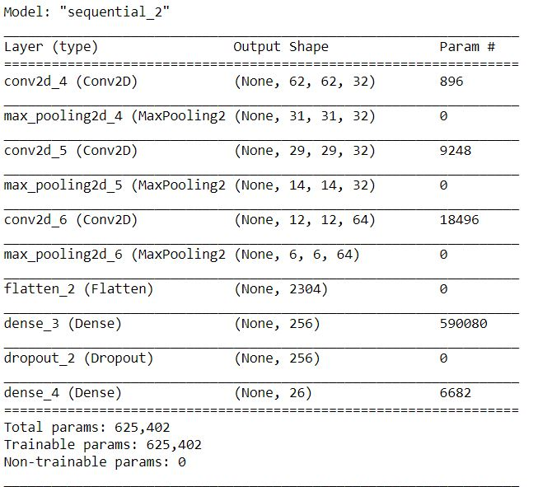
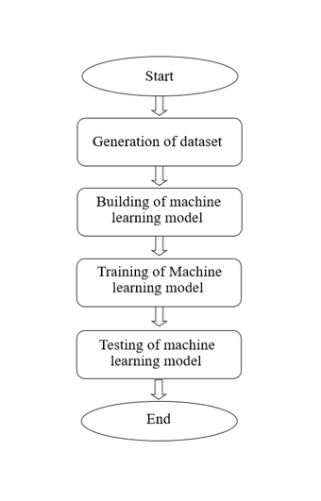
WORK FLOW:
Figure 3 : Flowchart for sign language recognition
Figure 4 : Convolutional nueral Architecture

Slide 15
DEMO

Slide 16
RESULT
The proposed ML model is designed to recognise alphabets using Convolutional neural network .
The trained model is able to identify the alphabets with the following accuracy values:
Accuracy = 98.52% (during the training of the model)
Accuracy = 96.57% (while using the Validation Set)

Slide 17
Applications
Communicating with physically challenged people.
Teaching school students.
Applicable during the announcement of news for hearing impaired people.
Communicating in confidential matters.

Slide 18
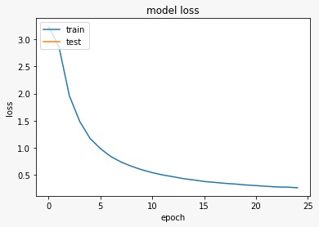
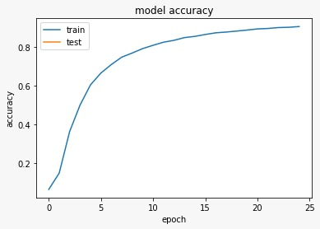
result

Slide 19
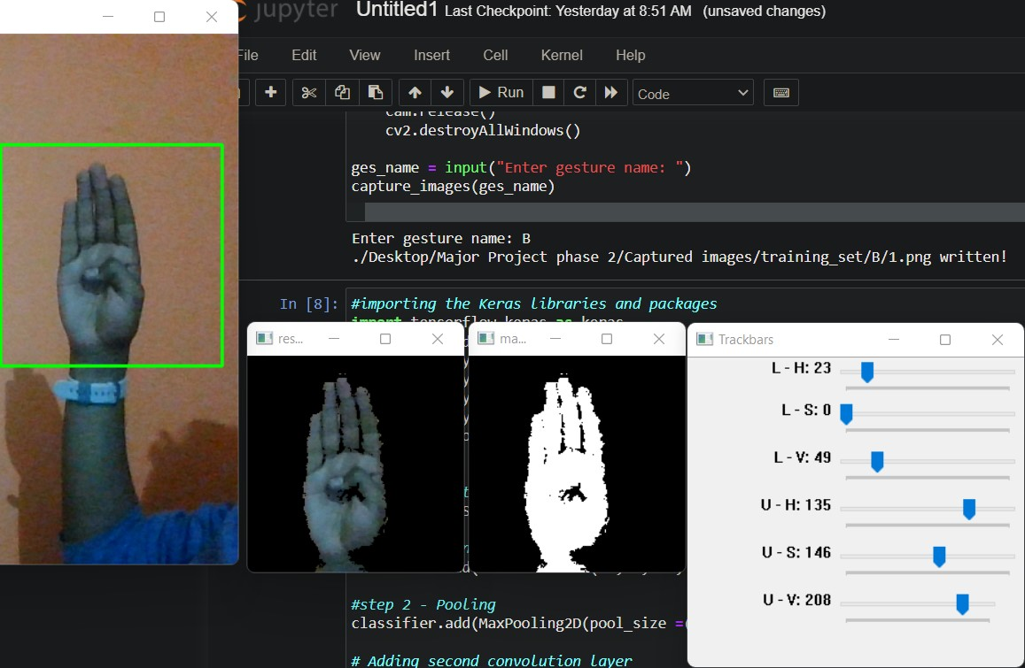
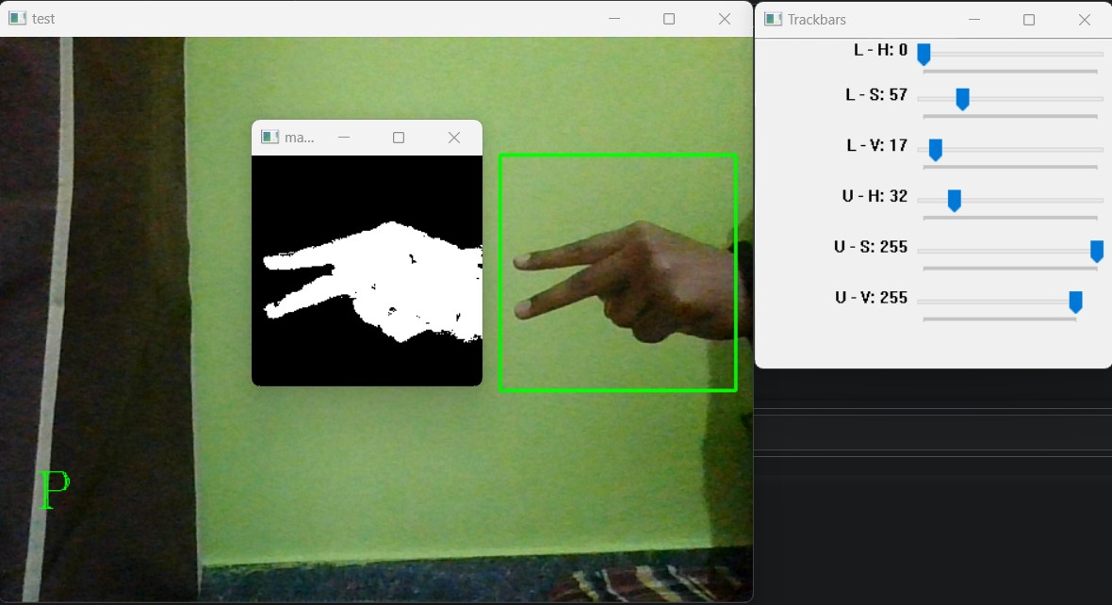

Slide 20
References
[1] Nagarajan, Sathish, and T. S. Subashini. "Static hand gesture recognition for sign language alphabets using edge oriented histogram and multi class SVM." International Journal of Computer Applications 82, no. 4 (2013).
[2] Izzah, Abidatul, and Nanik Suciati. "Translation of sign language using generic Fourier descriptor and nearest neighbour." International Journal on Cybernetics and Informatics 3, no. 1 (2014): 31-41.
[3] Agarwal, Rajat, Balasubramanian Raman, and Ankush Mittal. "Hand gesture recognition using discrete wavelet transform and support vector machine." In 2015 2nd International Conference on Signal Processing and Integrated Networks (SPIN), pp. 489-493. IEEE, 2015.
[4] Nikam, Ashish S., and Aarti G. Ambekar. "Sign language recognition using image-based hand gesture recognition techniques." In 2016 Online International Conference on Green Engineering and Technologies (IC-GET), pp. 1-5. IEEE, 2016.[5] Rokade, Yogeshwar I., and Prashant M. Jadav. "Indian sign language recognition system." International Journal of Engineering and Technology 9, no. 3 (2017): 189-196.
[5] Rokade, Yogeshwar I., and Prashant M. Jadav. "Indian sign language recognition system." International Journal of Engineering and Technology 9, no. 3 (2017): 189-196.
[6] Rosero-Montalvo, Paul D., Pamela Godoy-Trujillo, Edison Flores-Bosmediano, Jorge Carrascal-García, Santiago Otero-Potosi, Henry Benitez-Pereira, and Diego H. Peluffo-Ordóñez. "Sign language recognition based on intelligent glove using machine learning techniques." In 2018 IEEE Third Ecuador Technical Chapters Meeting (ETCM), pp. 1-5. IEEE, 2018.
[7] Wadhawan, Ankita, and Parteek Kumar. "Deep learning-based sign language recognition system for static signs." Neural Computing and Applications (2020): 1-12.
[8] Pratama, Yohanssen, Ester Marbun, Yonatan Parapat, and Anastasya Manullang. "Deep convolutional neural network for hand sign language recognition using model E." Bulletin of Electrical Engineering and Informatics 9, no. 5 (2020): 1873-1881.

Slide 21
Thank You…..

